Slide 1

A Refreshing Intro to
Todd “there’s no R in plankton” O’Brien
NOAA Fisheries
(… but there is an R in fisheries …)

Slide 2
Goals of this Intro/Refresher
To introduce you to “R” and “RStudio”
It’s not all command-line … you can point-and-click some*
To introduce you to the R vocabularies
Vectors and factors and data.frames … oh my!
To show you some of the mechanics behind and leading up to the afternoon session
MaRcus would be incomplete without R

Slide 3

I am not an R-tist
I am more of a PiRate …
(Rrrrrrrrrr, matey!)
A PiRate knows the internet is a treasure chest full of precious gold code. We google, raid, and pillage online blogs and demo scripts to get working code tidbits for our own needs.

Slide 4
I am not an R-tist
I am more of a PiRate …
(Rrrrrrrrrr, matey!)
A PiRate knows the internet is a treasure chest full of precious gold code. We google, raid, and pillage online blogs and demo scripts to get working code tidbits for our own needs.
Seriously, it is usually easier to modify a working example than to read/understand the help files.

Slide 5
What is “R”
R is a language and programming environment for statistical computing and graphics.
R is available as Free Software under the terms of the Free Software Foundation’s GNU General Public License in source code form.
R can store, process, analyze, and graph a wide variety of data types.

Slide 6
Caution! R syntax can put the “R” into
“R you @#$@# kidding me?!”
and
“ARRRRRRRRRGH!”

Slide 7
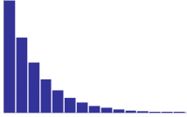
The R Learning Curve
Time spent trying to get it
to work the first time
Reduction in time if you document and
keep working code tidbits for re-use later

Slide 8
The R Learning Curve
ME
Time spent trying to get it
to work the first time
Reduction in time if you document and
keep working code tidbits for re-use later

Slide 9
The R Learning Curve
ME
Time spent trying to get it
to work the first time
MARCUS
Reduction in time if you document and
keep working code tidbits for re-use later

Slide 10
The R Learning Curve
ME
Time spent trying to get it
to work the first time
Reduction in time if you document and
keep working code tidbits for re-use later

Slide 11

The R Learning Curve
Time spent trying to get it
to work the first time
MARCUS
Reduction in time if you document and
keep working code tidbits for re-use later

Slide 12
When “R” first came out
The R Interface (before Rstudio)
One had to save their workspace, command history, and current working directory by hand ... E-very time
One had to use commands to do everything
One usually had to edit scripts in a separate program
Finding/Installing/Using packages and libraries was much harder
GitHub and similar did not exist
Installing was not a single command process
Error messages were often cryptic (or ambiguous)
The Cheat Sheets (help sheets) were scary … pages and pages of bizarre text and numbers

Slide 13
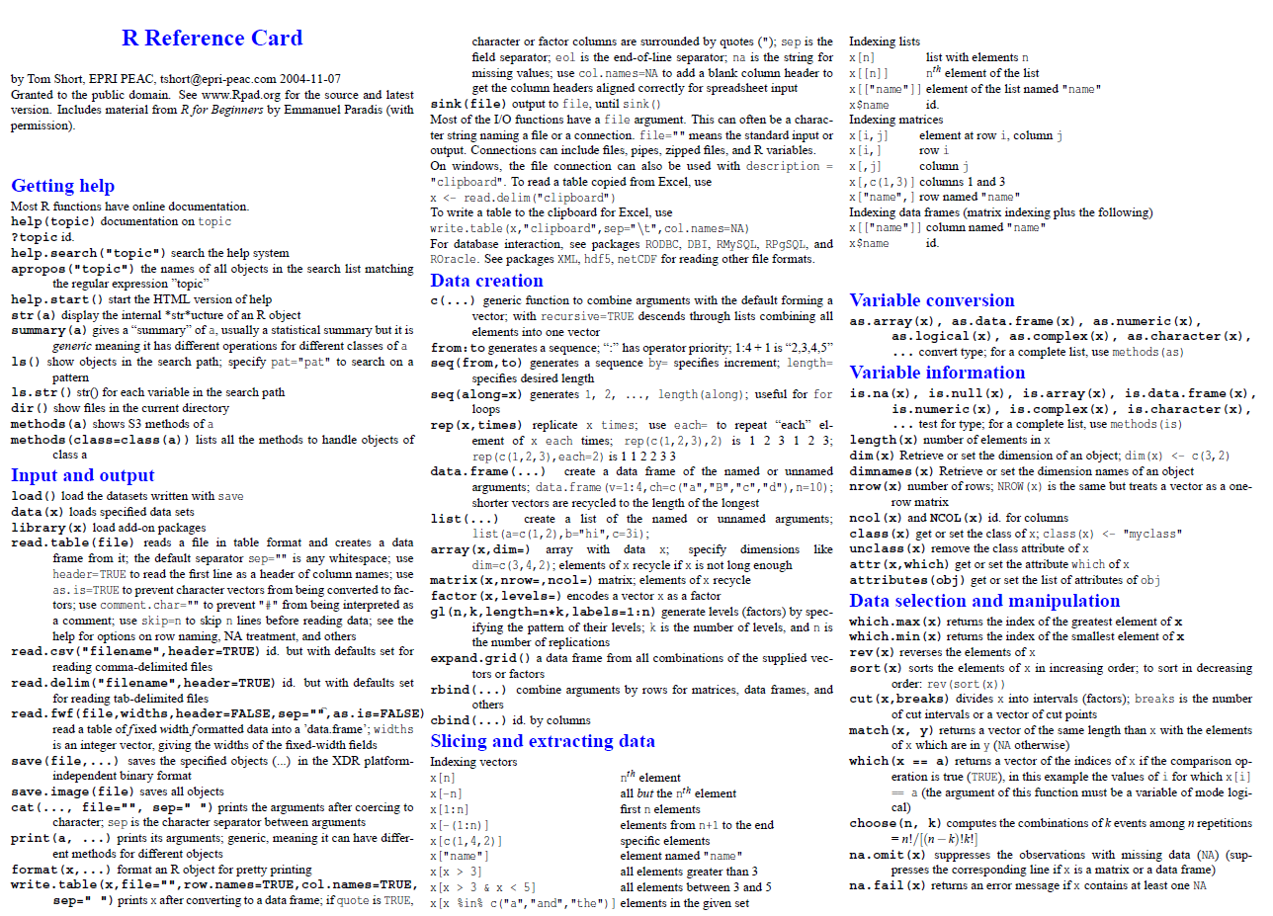
Example “Old School” Cheat Sheet

Slide 14
The “R” World now …
Wonderful supplemental tools like RStudio exist, making “R” operate more like other mainstream PC/Mac programs.
There is a thriving user community and hundreds of online web pages, blogs, and forums providing help and sharing ideas. One can Google a rough question and find answers (“R double axis bar graph”)
Many really excellent libraries and packages exist (like Marcus’)
Many of these new libraries and packages provide plain-English explanations in their help files
Some really excellent “cheat sheets” exist .. with color and illustrative examples

Slide 15
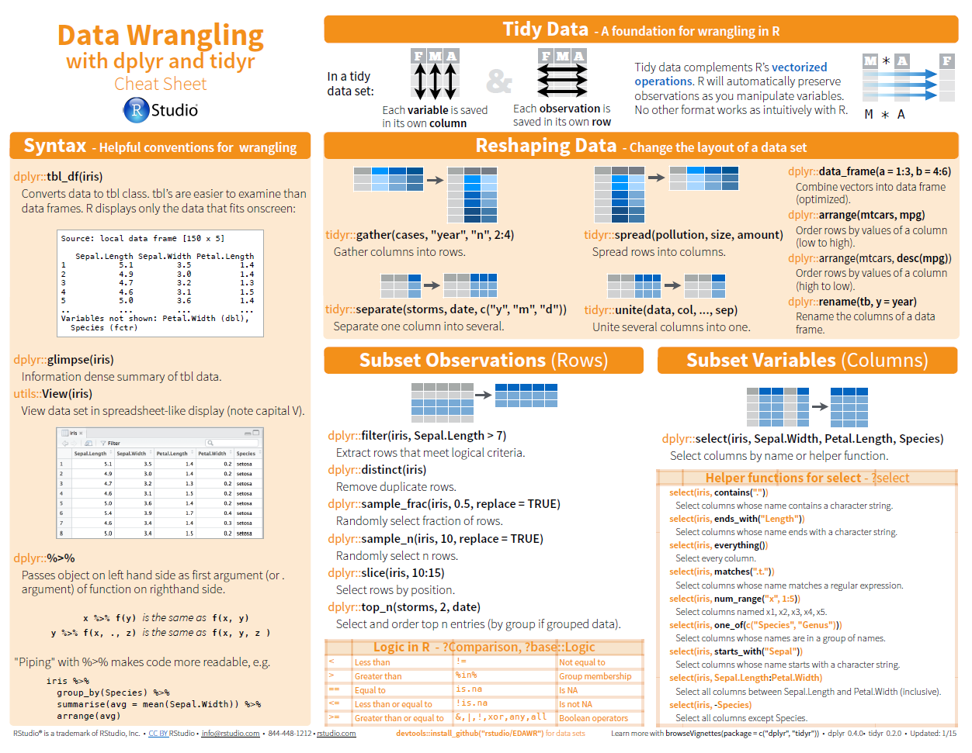

Slide 16
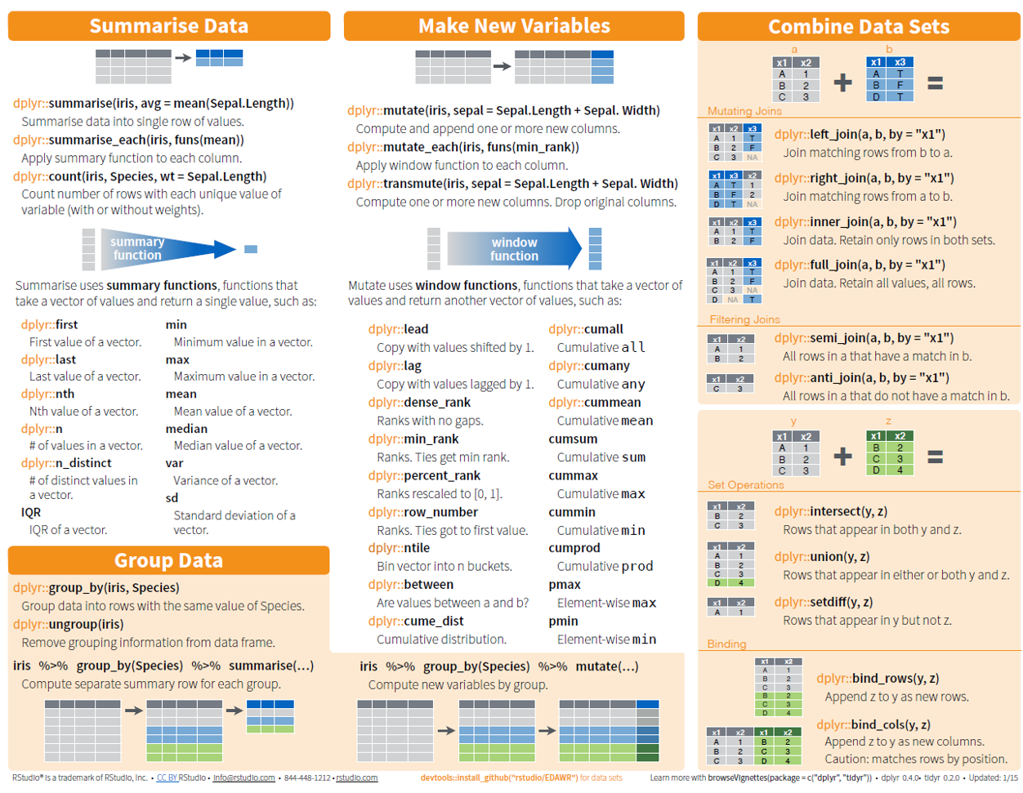

Slide 17
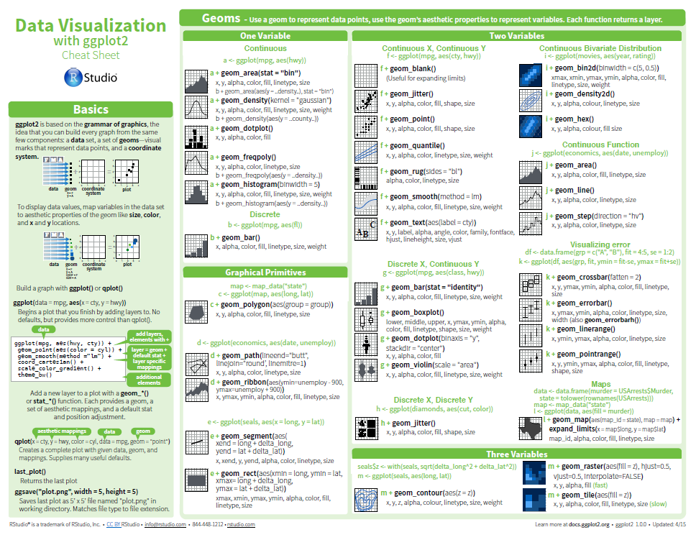

Slide 18
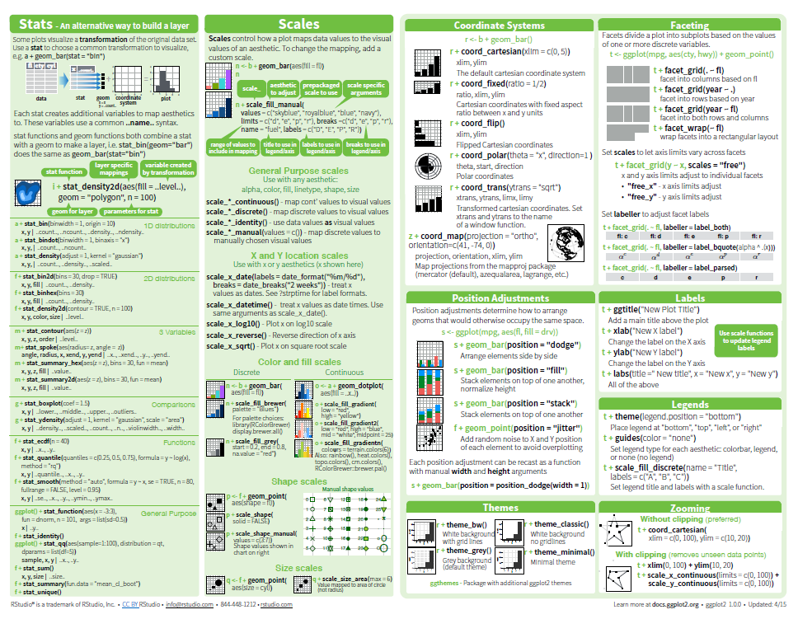

Slide 19
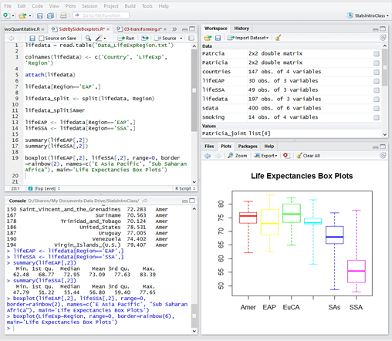
What is RStudio?
Rstudio is a free R integrated development environment (IDE).

Slide 20
What can RStudio do for you?
Convenient/Handy features:
Your plotted figures are managed for easy viewing (useful with multiple figures). You can also print or save (export) them to PNG, PDF, or JPG.
Rstudio will automatically save your “workspace”, “command history”, and “working directory”.
You can view and edit one or even multiple scripts within the Rstudio windows.
Many of the install features are much easier (no need to select mirrors and repositories).

Slide 21
What can Rstudio do for you?
Game-Changing Features:
You quickly can see exactly what variables are active, what they contain, and see what “type” (class) they are
Script editors have syntax highlighting
You can “step-by-step” through each line of script, or run the whole thing with a single click
Auto-pairing of (), [], “” and auto complete helps with variables and functions
You will see most/all of these this morning/afternoon.

Slide 22
The Rstudio sub-windows

Slide 23
The Rstudio “Project” automatically handles the
Current Working Directory (CWD)
Default area to load files from
Default area to save files to
R workspace
This is your loaded/stored/created data and variables
Command history
These are all the commands you typed
good for remembering
Any currently-open Scripts
“Save your script” reminder (colorization)

Slide 24
Three most Important Things you should learn today
Always try a new function or operation before assigning it to a variable or using it in a function
Save each working line into a script file
Less typing = less errors + less to remember later
Document EVERYTHING … at a level that will make sense a week, month, or year from now.

Slide 25
Scripts and Documentation for an EasieR Life
Why? Because a month+ from now you may not remember every little aspect. A year from, almost definitely. Sometimes even in a day!
Research it once, debug it one, code it once ... document it once.
Use the command line for testing, but use scripts for repeat actions and long-term archiving. Cut-n-paste, modify-n-reuse
Document the details and the anguish too
This must be a [X arr] with $ or it won’t work
A year from now, you will appreciate the documenting done now.

Slide 26
Tricks for Scripts
If making major changes to a working line. Make a copy of it. (Keep it but turn it off with a “#”.)
If making major changes to a script you have been working on for a while, make a safety backup (“my-work__backup.R”). It is easier to delete redundant copies than to restore/repair/re-debug a corrupted copy.
If working with multiple version of scripts, adding the date into the file name helps. ( oxygen-plots__2015-oct-25.R )

Slide 27
R data types (classes)
Numeric (aka “real” or decimal point)
Character
Logical (TRUE/FALSE)
Vector (multiple elements of consistent type)
a <- c(1,2,5,6,)
b <- c("one","two","three")
c <- c(TRUE,TRUE,TRUE,FALSE,TRUE,FALSE)
List (mixed element types)
Note that a vector of 3,4,x is actually “3”, “4”, “x”
A list can mix num and char

Slide 28
R data types (classes)
Vector
“an array”
multiple elements of same class
Matrix
all columns must have length
Entire matrix must be a single class
Data Frame
“a table”
Columns can be different lengths
Each column can be different classes

Slide 29
R Packaging
“Command”
Calling of a math, plotting, or other function
Script
A saved-to-file sequence of multiple commands
Function()
A collection of one or more commands to which you can pass parameter(s) and an action or result is returned
Library()
A collection of Functions
Package
A collection of one or more Libraries stored in a (package) for external-to-R storage or distribution.
The “Package” process checks for dependencies and errors

Slide 30
On naming VaRiables
Capitalization Matters
DATE, Date, and date are three different variables
as.Date() is a function, as.date() is an error message
Use “_” and “.” to inter-relate sites or variables
WQBCR main data.frame from CSV
WQBCR_temp temperature column (raw)
WQBCR_temp.mon monthly-averages temps
WQBSP_oxy.mon SageLotPond monthly oxygen
If you are using scripts, which you should be, these longer variable names are typed infrequently (usually just cut-n-pasted) and they help with documenting and differentiating

Slide 31
OTHER RESOURCES
Paper Books?
View them “in person”. Every person has a different preference, every book has a different style.
Online Guides
“Quick-R”: http://www.statmethods.net/index.html
Time Series-related: Time Series-related: http://a-little-book-of-r-for-time-series.readthedocs.org/en/latest/
“Google It”

Slide 32
THINGS TO WATCH
Capitals matter everywhere!
as.Date(WQB[[1]],"%m/%d/%Y")
%Y = 1998
%y = 98
() is not the same as []
() is for function calls
[] is array indexing
WQB[2] is not the same as WQB[[2]]
class(WQB[2]) data.frame
class(WQB[[2]]) vector
Some libraries “mask” existing functions.
SWMPr gives a warning that it masks “as.Date”

Slide 33
About my scripting style …
My commenting is a mish-mash of comprehensiveness. As we getting deeper into the scripts, I will throw in un-commented lines that were described in an earlier script.
You are encouraged to add your own comments or re-write what is already there.

Slide 35
More stuff (the “ggplot2” package)
install.packages("ggplot2")
library(ggplot2)
qplot(x,WQB[[2]])
qplot(x,WQB[[2]],ylim=c(0,10))
hist(WQB[[2]],breaks=5)
hist(WQB[[2]],breaks=5, col="royalblue3")
Examples of labels and such?

